Slide 1

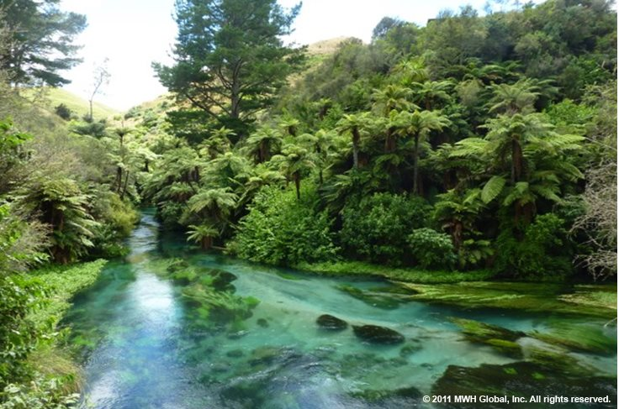
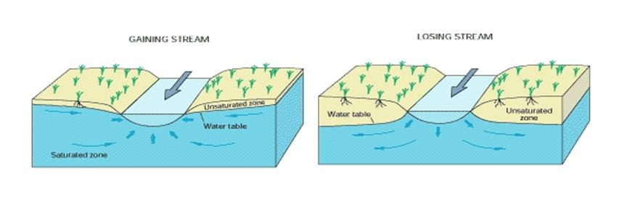
Building flexible River Basin Modeling Systems for today's challenges in Water Resources Management
Enrique Triana, Ph.D., P.E.
Eric D. Morway, Ph.D. (USGS)
Rich G. Niswonger, Ph.D. (USGS)
Steve Regan (USGS)
ClimWar Launch Worshop
Chile, January 28th, 2019

Slide 2
Modeling Water Resources Systems Key Elements
Capture the dynamic and interdependency between the Surface water and Ground water systems
Building tools for uncertainty analysis and informed decisions

Slide 3
Simulating River Basins with Enhanced Conjunctive Surface and Ground Water

Slide 4
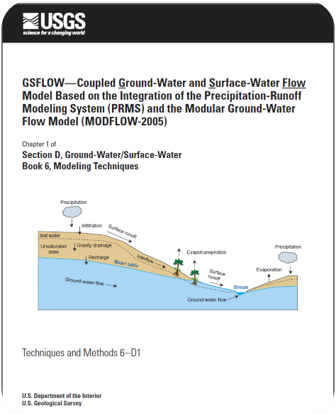
GSFLOW
PRMS
MODFLOW
Simulates key hydrologic processes in watersheds
Climate
Snow dynamics
Land-use processes
Depression storage
Groundwater system
SW-GW
Dynamic land-use
Development
Agriculture
Water use
Pumping
Artificial recharge
Notes:
The point on this slide is that GSFLOW is a fully-integrated watershed-scale/subsurface hydrology model. Explicitly simulated all of the physics that control various aspects of the water budget.

Slide 5
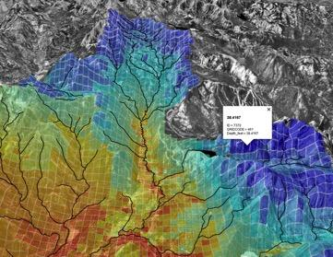
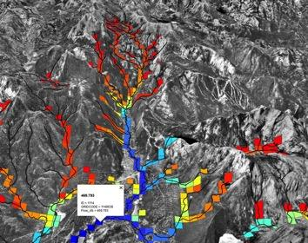
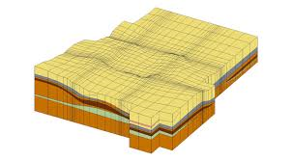
GSFLOW Groundwater System Modeling
Snowpack and rain forecast
PRMS
Uses predefined Surface Water Diversions (SFR)
Runoff to rivers
MODFLOW
3D representation Groundwater System
Water-use information is sometimes unavailable and/or incomplete; however, the framework governing water-use is well-defined
Specified water-use precludes our ability to run scenarios

Slide 6
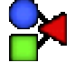
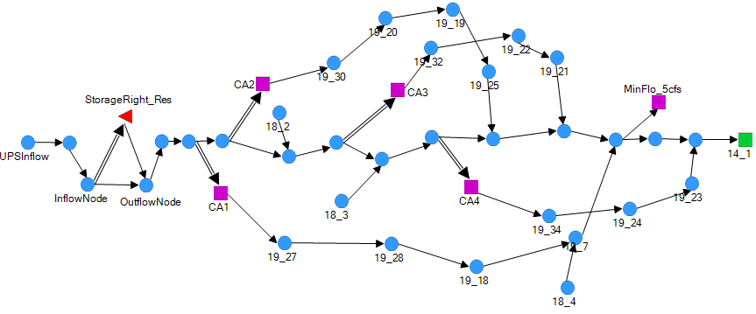

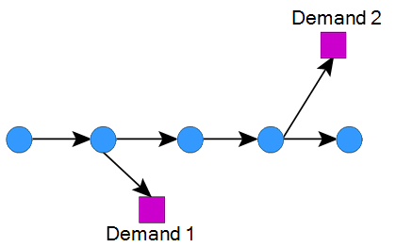
MODSIM DSS Surface Water Allocation
Surface Water Allocation Logic
Demand (7 m3)
Higher
Example Features
Water rights allocation under prior appropriation doctrine
Storage rights & storage accounts operations
Water exchanges
Minimum Flows
Nat. Inflow (10)
Lower
Demand (7m³)
Usually includes simplifications to the stream-aquifer interaction, limiting the ability to apply correctly the allocation logic
Notes:
MODISM like many other operations models include simplifications of the stream aquifer interaface, limiting the ability to ….

Slide 7
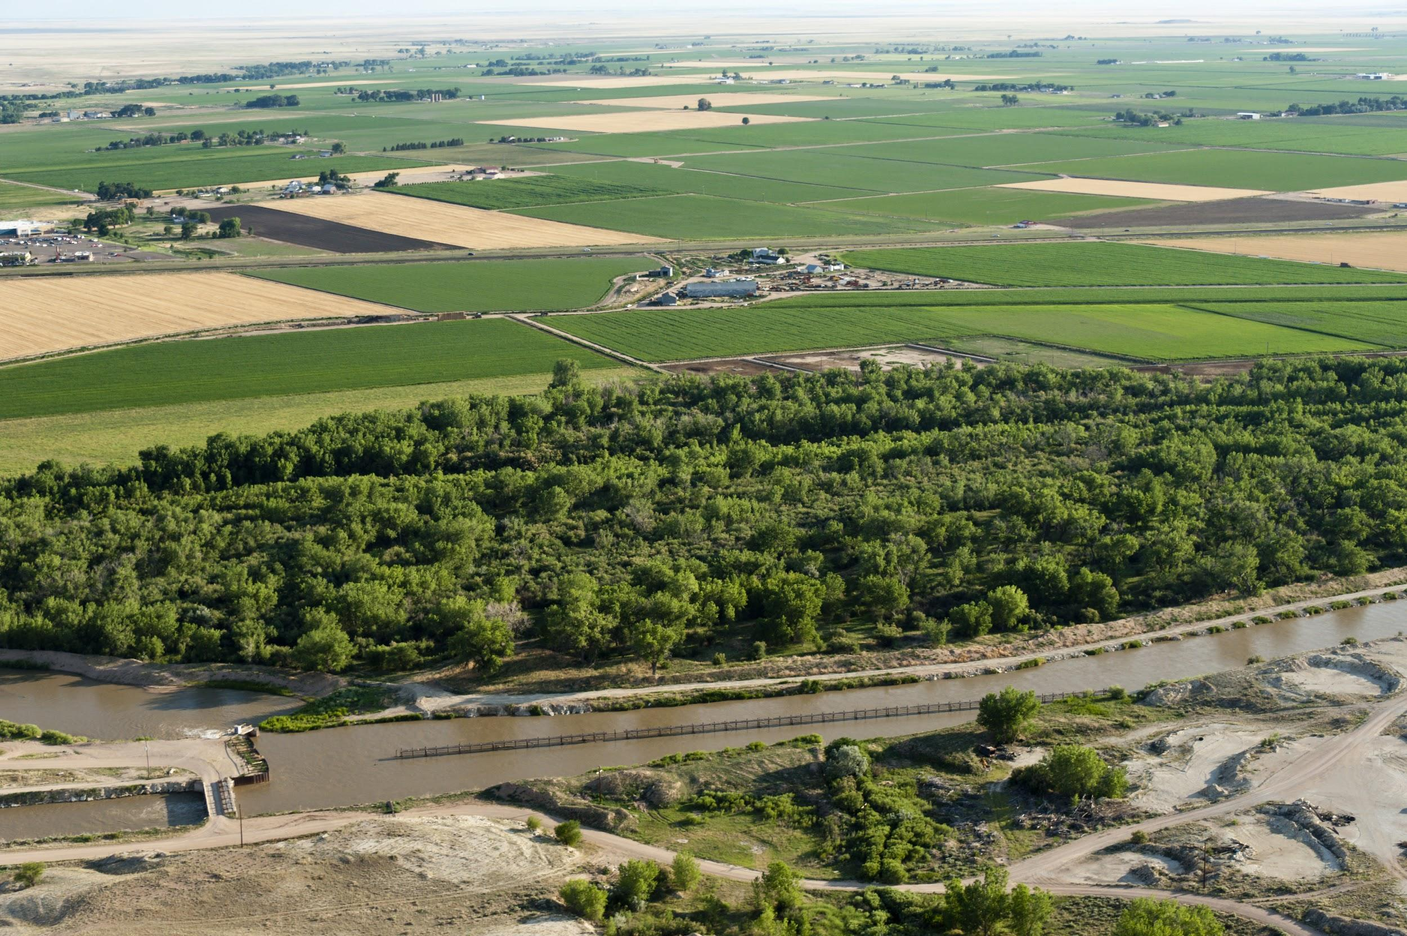
Problem Motivation
A lot of river-operation models are not as physically realistic as they need to be for conjunctive use management/investigations
Notes:
We are reaching the point of having many river basins overallocated, where demand is reaching the supplies. An accurate accounting of stream aquifer interaction is key in water resources management.

Slide 8
New Tool for Conjunctive Use Modeling MODSIM – GSFLOW Coupling
Surface Water System is linked with the gridded system representation

Slide 9
New Tool for Conjunctive Use Modeling MODSIM – GSFLOW Coupling
Dynamic Variable Exchange
Water Rights
Storage Accounts
Land Runoff to Rivers
MODSIM
GSFLOW
Iter.
i
Water Allocation (Diversions & Reservoir Releases)
Reservoir Evaporation/Seepage & Hydraulics
Stream & Canals Accretions/ Depletions
By MODFLOW Segments
Lake Simulation

Slide 10
Benefits of New Conjunctive Use Modeling Tool
PRMS
MODFLOW
MODSIM
All new functionality in MODSIM
Simulation of snow/rainfall-runoff processes with land use assumptions
Improved representation of spatially distributed groundwater/surface-water exchanges
All new functionality inside MODFLOW
Reservoir storage accounting
Runtime diversions based on
holistic view of river system
Integrated code allows managing GW and SW as a single resource
Flexibility of running each model independently
Notes:
We also have the ability to explore alternative management scenarios that ultimately enhance groundwater sustainability, look at different hydrologic responses under alternative land-use schemes, or alternative river operations.

Slide 11

Carson Valley Application of MODSIM-GSFLOW
Notes:
A real-world application of the code to NW NV, a snowfed system

Slide 12
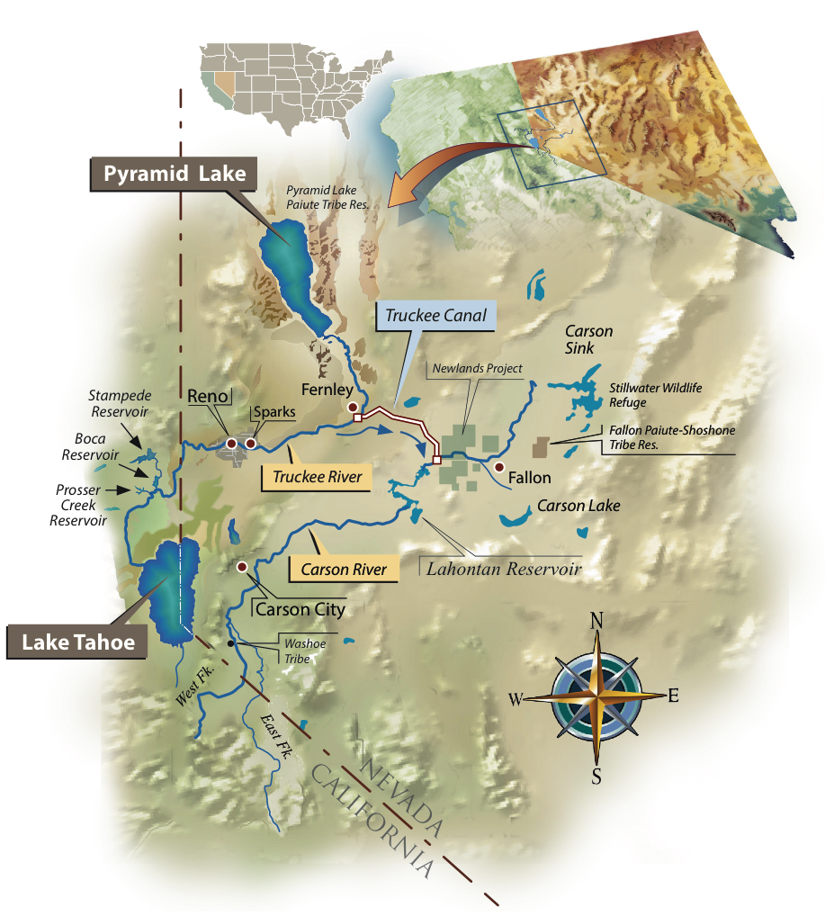

Investigate the impact of a changing climate on river operations
PRMS model of headwaters
PRMS model provides streamflow into integrated MODSIM-GSFLOW model of Carson Valley
Model scenarios consist of warming up the PRMS model and evaluating the impact on individual water rights
Design and Graphics by Kelley Sterle and Ron Oden, UNR
Notes:
Climate change is impacting the timing of runoff, and there is no upstream storage. Hence, as more precipitation falls as rain, or snowmelt occurs earlier, the available water won’t be available when it is needed, it will have already flowed downstream.

Slide 13
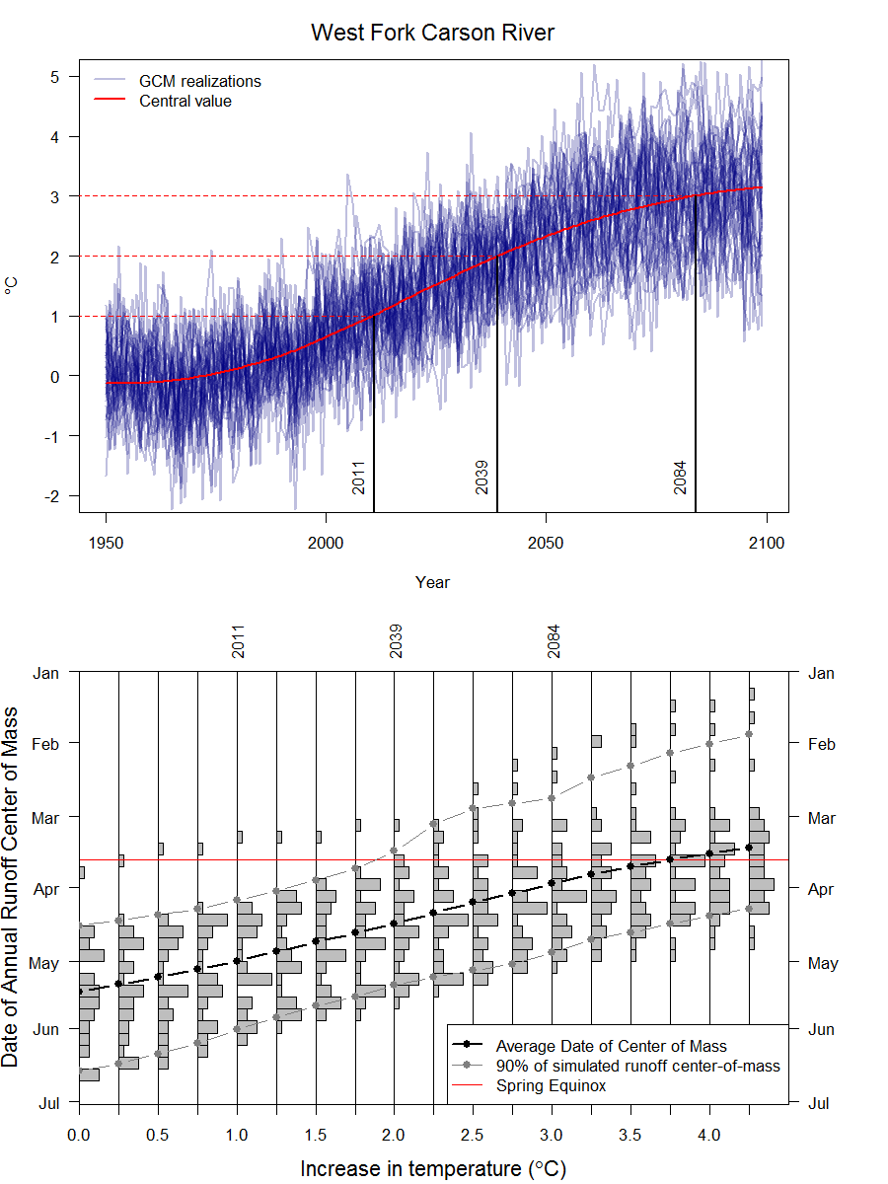
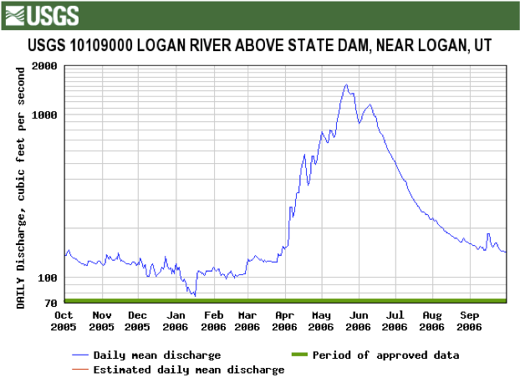
Center-of-mass of 50% of total annual runoff for different levels of warming
2011
2039
2084
2011
2039
2084
Notes:
Stakeholders wanted us to use historical climate (temperature/precip) record.
This timing issue more than highlights the need for an integrated hydrologic-operations model, but more importantly, highlights the need to consider and potentially start implementing pilot studies that include Managed Aquifer Recharge, or others that you the stakeholders find collective agreement on. Note from Eric after 2/20/2018 SAG: In future presentations of this work, I think it should be stated explicitly (somehow highlighted, anyway), that a key feature of the integrated model is that it has no hard-wired diversions, and that is what ‘allows’ the water to make it through to Lahontan. That is, I think it is clear in our minds because we know the model so well, but I’m not sure this link is made in the minds of the stakeholders. So for example, when discussing the plot shown to the right, what we need to then point out is, “look, the operation model is not going to tap into the earlier hydrograph because it is going to first honor the alpine decree’s start-of-the-irrigation season start date.” The stakeholder’s immediately recognize that this is how it works out in reality, but there is no model prior to MODSIM-MODFLOW that could do this on the fly and in priority.

Slide 14
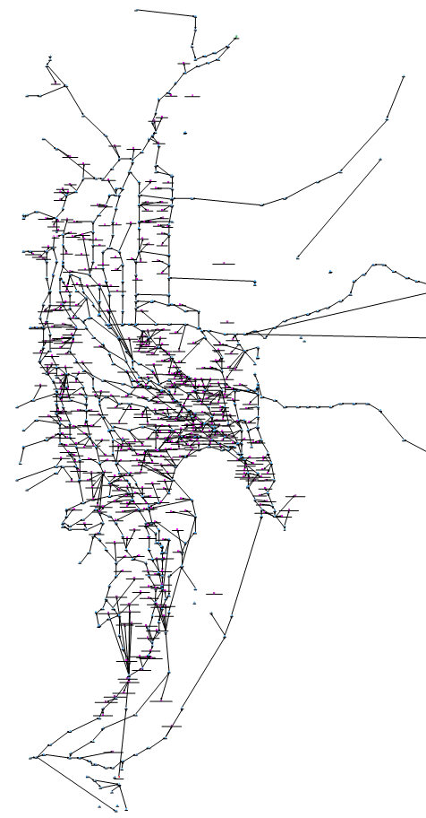
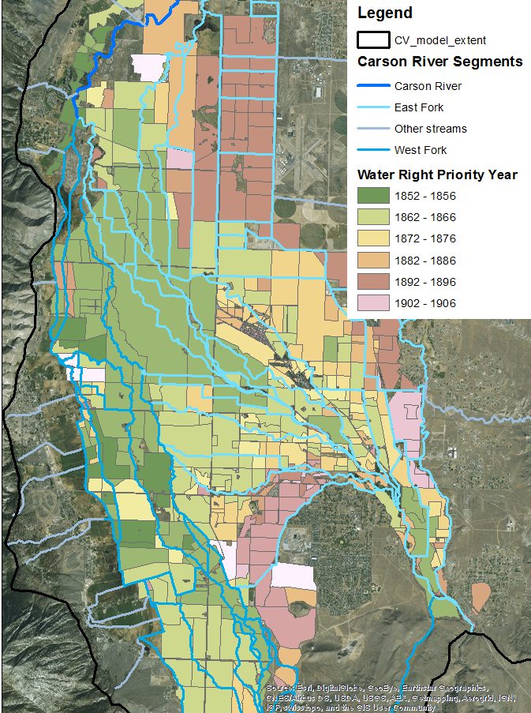
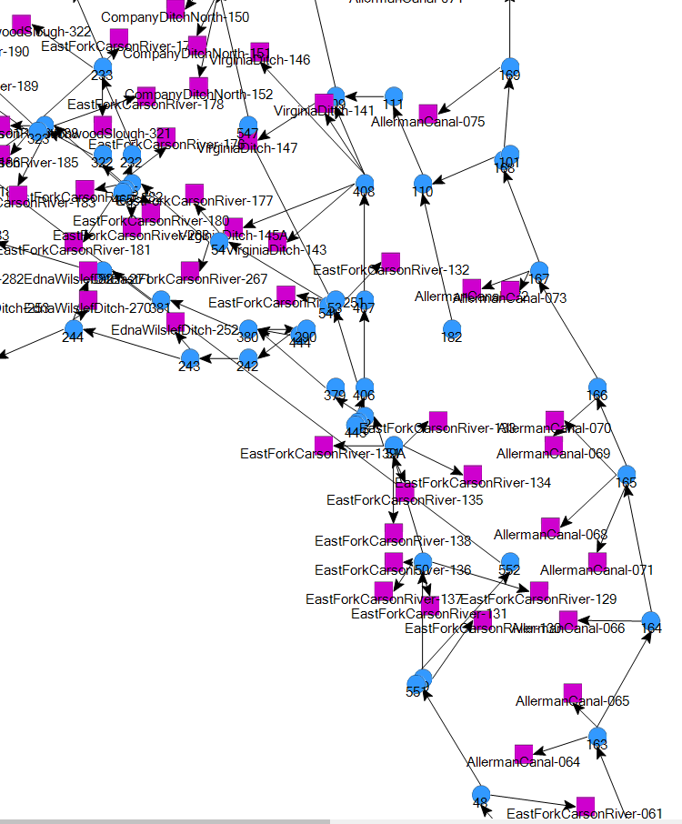
MODSIM - Carson River Operations Model
Return Flows
Notes:
Our model accounts for the Alpine Decree framework (Digital representation of the Alpine Decree)
Decree date, Allerman Split, Reservoir operations. The integrated code allows us to “…” (Don’t make aggressive statements like “we couldn’t do such-and-such without the integrated code.”) We’re resolving down to the individual water right level, which is critical for getting stakeholder involvement. By getting it down to this level, stakeholders are engaged.
Also note the incredible amount of spatial heterogeneity in the spatial distribution of water rights. As return flows get plugged back into the surface-water (MODSIM) network by the hydrology model, they will be routed to the next senior-most water-right that is possible to deliver to.

Slide 15
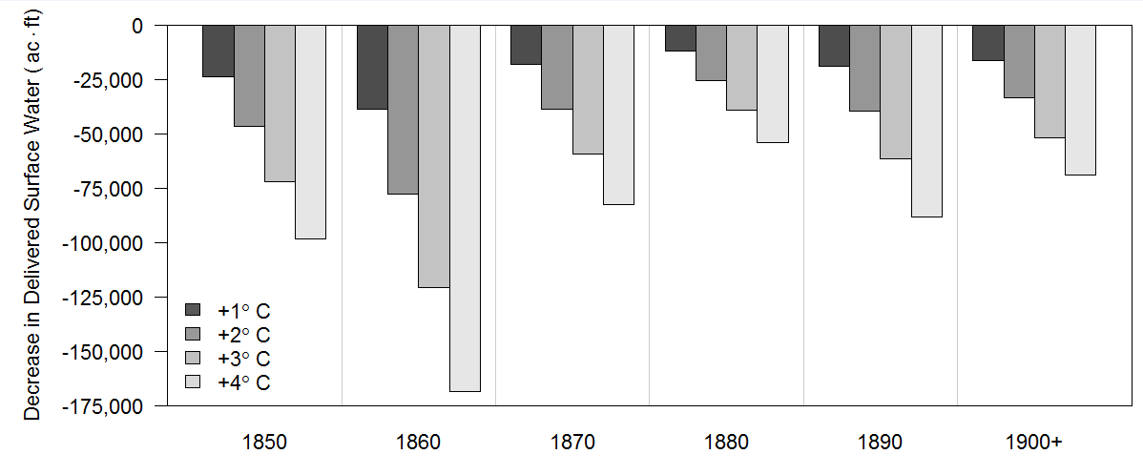
Reduction in Simulated Deliveries
Total Delivery – All Decades
Simulations for 1980-2015
All Results are differenced from Historical +0C
Seniority
Water Right Decree Date by Decade
Notes:
1. clear-up up x-axis
2. A lot of uncertainty in climate. If only 1 deg of warm-up, what is the impact
3. The pre-conception by senior water right holders is that future climate is going to affect them by virtue of the fact they are most senior. This shows, for the first time, that even the senior water right holder are in fact impacted. Why are the senior water right holder seemingly impacted the most? Then explain…

Slide 16
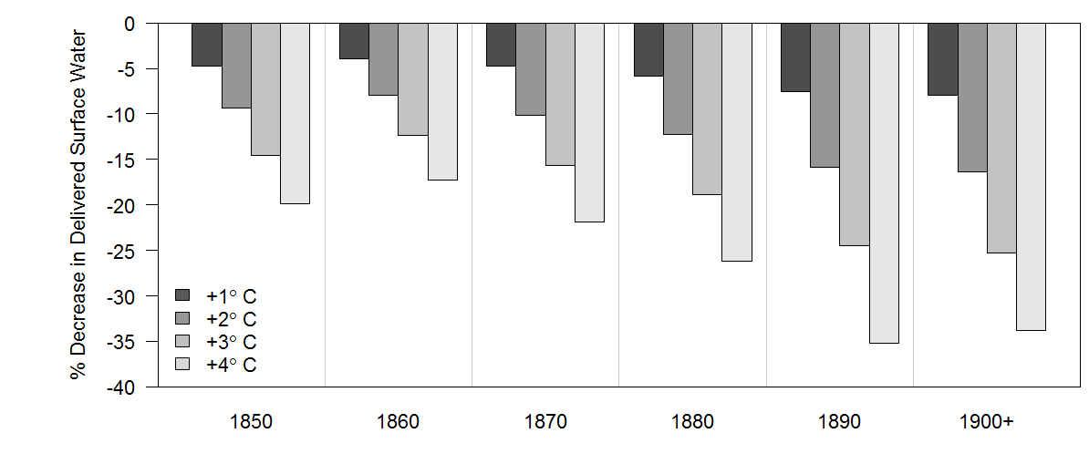
% Change in Delivery – All Decades
Seniority
Water Right Decree Date by Decade

Slide 17
Modeling Systems to Cope with Uncertainty

Slide 18



Motivation
Present
Decision making under deep uncertainty
System Conditions
Demand
Supply
Actions
Consequences
Future
Don’t known or cannot agree on
the probability distribution of inputs
Transition from Traditional Planning to Planning under Uncertainty

Slide 19
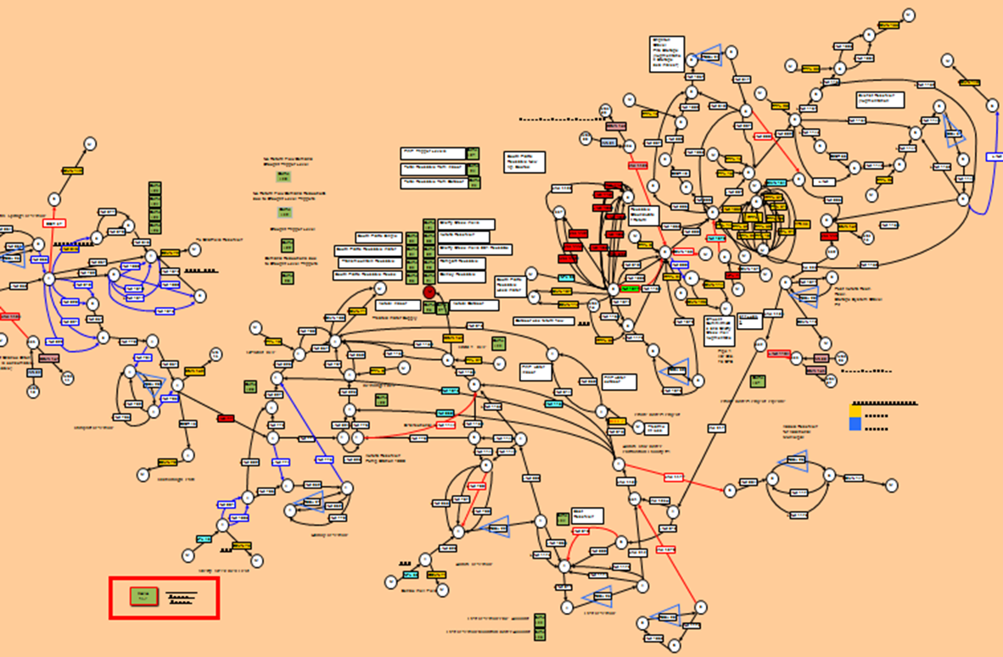

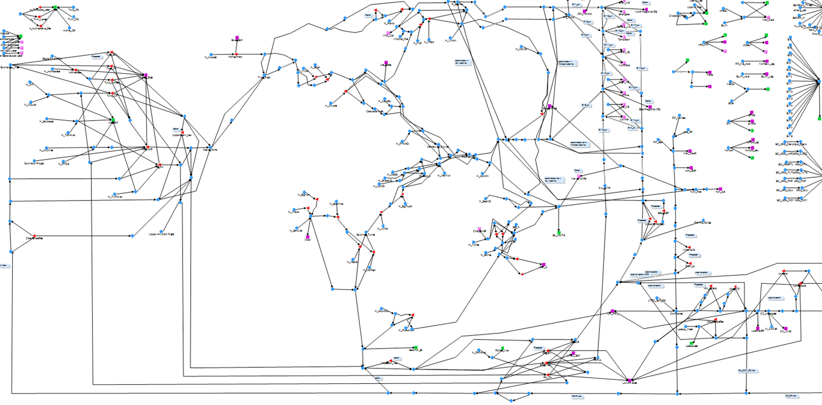

Simulation models are powerful tools to predict system responses
Climate Change
Simulation Models
Climate Variability
CRAM System Model
Complex Operations
Input Variables Access
Output Access
Water Rights
Vulnerabilities
Infrastructure Failures
System Response
Contracts/ Leases
MODSIM Model
Drought Response
Water Quality
Solutions
Notes:
Uniqueness feature -> each municipality has a preferred modeling system
Exchanges
Reservoir Operations
Trans-Mountain Diversions
Vulnerability
Infrastructure failure
Water Quality
Blending

Slide 20
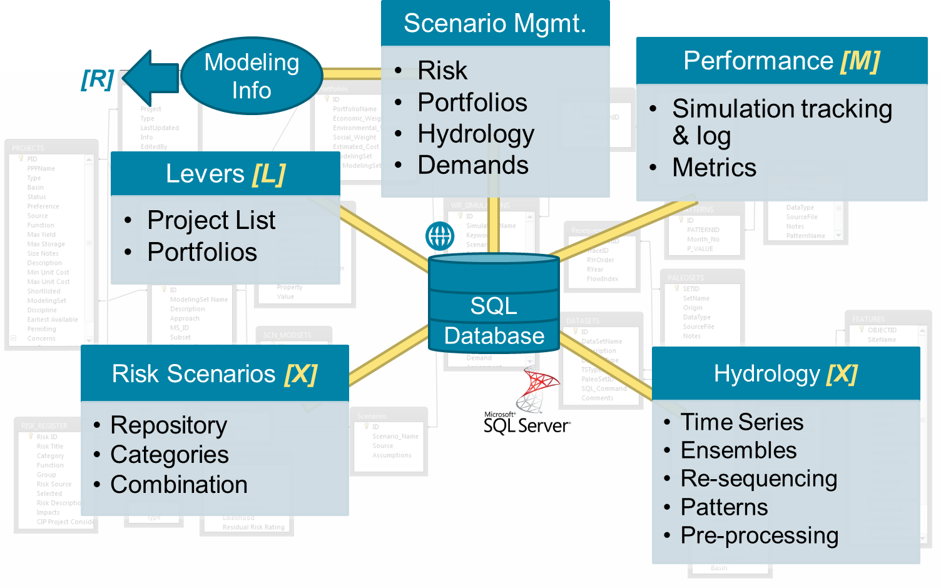



Modeling management systems as solutions to support decision making under uncertainty
Simulation Models
Performance
Metrics
Simulation tracking & log
Scenario Mgmt.
Risk
Portfolios
Hydrology
Demands
CRAM System Model
MODSIM Model
Adapter
IWMP
Modeling
Management
System
(MMS)
SQL
Database
PACSM Model
Central Control and Repository
Reusable Libraries
CalSim II
Model
Automated Simulation
Notes:
Fundamental piece of the framework is the DMS
Implements the concept of adapter to stablish communication between the models – and the DB
Understands information coded in the database and translates to model input variables.
Understands the output of the model and extracts what is important – RESPONSE from the system.
Simulation tracking and organization – is key in analysis of the results (later in the presentation)
Simulation Models minimum requirements
Programmatic access to the input variables
Programmatic access to the output.
A PLUS is run time customization – extend the possibilities

Slide 21
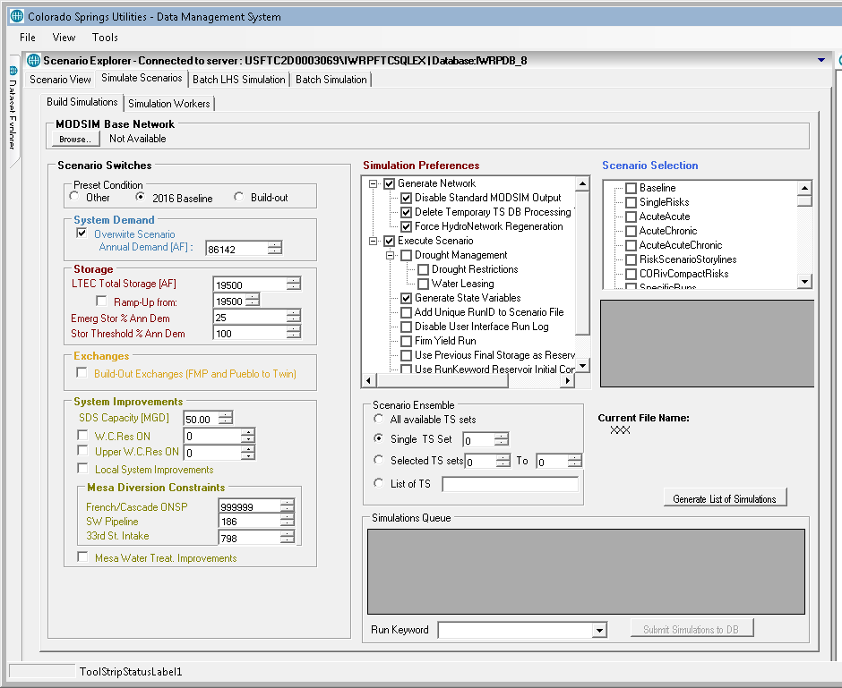

Increased ability to Simulate Future Scenarios Parallel Computing Setup
Initialize Workers
(by Keyword)
MMS
For each worker …
Submit
Work
(Keyword)
Setup Running Workspace
SQL
Database

Slide 22
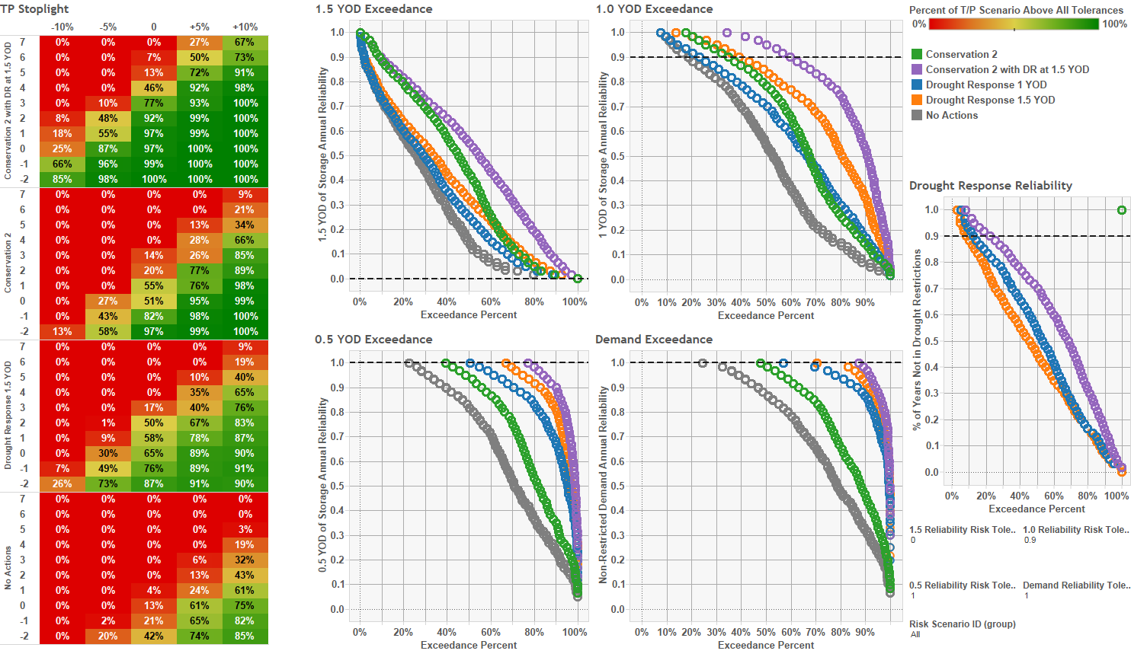
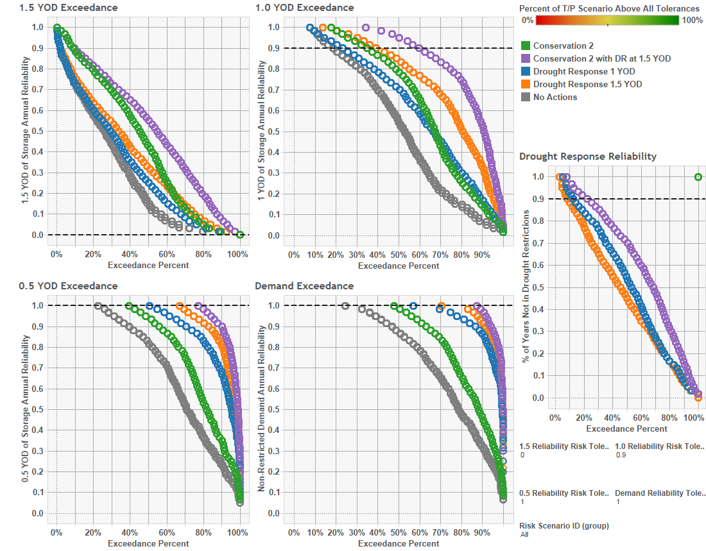
Effect of climate on system performance with conservation and demand management levers
Precipitation Offsets
Different Scenarios
Temperature Offsets
Notes:
More information and a different approach generates a new challenge
Thresholds
Accepting and embracing uncertainty
How we package and present the information (VISUALIZATION ) is key in
4 sets of stoplight diagrams showing how well the system performed for different hydrologic conditions. Stoplight diagrams have Precip changes in columns and Temp changes in rows. 4 sets represent different demand management scenarios – conservation programs and drought response programs.
This kind of plot is the most detailed and complex way to evaluate results and would be used with select technical staff who are heavily involved in the project to direct future modeling efforts. Without needing to understand what every plot means, this view was used to evaluate different demand management strategies, with each one as a different color, and their effectiveness at improving performance for a variety of future climate conditions under a variety of different system risks. This view collapses 30 system risk scenarios, 50 climate change scenarios, 7 different base hydrology traces, 5 demand management strategies, and 5 measures of system performance into a single interactive dashboard that, once understood

Slide 23


Coupling Simulation Models and Optimization Modules for Robust Solutions Search
Simulation Model
Output
Input
File
Data Management System
(DMS)
System Performance
SQL
Data Preparation
Database
Write
Objective Function
Read
Write
Preferences
Read
Read
Decision Variables
Write
DMS: Provides control of the simulation process for the optimization Module (Batch Mode)
Multi-Objective Optimization
Notes:
Here is the power of simulation & optimization
This setting allows the system to have a “life of its own”

Slide 24
MMS Concept Summary
Key Features
Central repository for data and modeling support
Automated Simulation
Efficient simulation (multi-cores/clusters)
Reusable libraries but customized application
Advantages
Use the full simulation model to approximate complexity
Address fear of modeling volumes
Definition of metrics and performance in the process is important
Modeling control system and organization
Focus on understanding the system and its responses

Slide 25
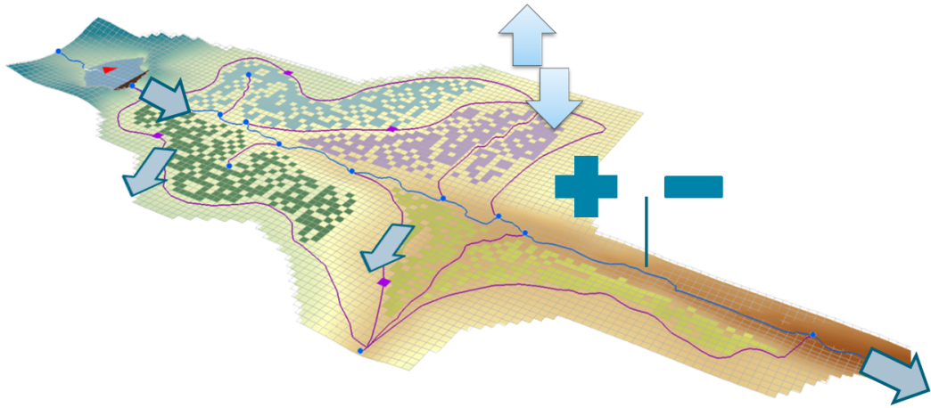
Summary New Conjunctive Surface-Ground water Modeling Tool
Enhanced Conjunctive SW-GW Modeling
New modeling approach for Conjunctive Use Modeling
GSFLOW + New functionality to incorporate river administration and operations
MODSIM + New spatial runoff and groundwater modeling functionality

Slide 26
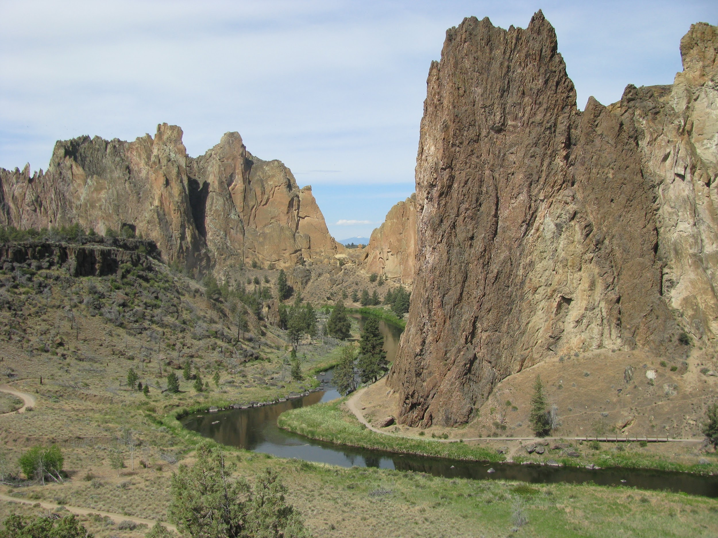
Applications
MODSIM-MODFLOW theory and description [published in EMS]
Agricultural Managed Aquifer Recharge (Ag-MAR) [published in WRR]
Carson Valley, NV [in development]
Russian River Basin, CA
[in development]
Deschutes River Basin, OR
[in development, integrating
existing models]
Others: Other basins?
Crooked River, Deschutes Basin, OR
Notes:
Walker is a great example of getting non-intuitive results that only could get from a full model, simplied models will not work in a case like this.
There are a lot of these models already out there and they just need integration for a more powerful tool. Developing on established and widely applied codes.

Slide 27

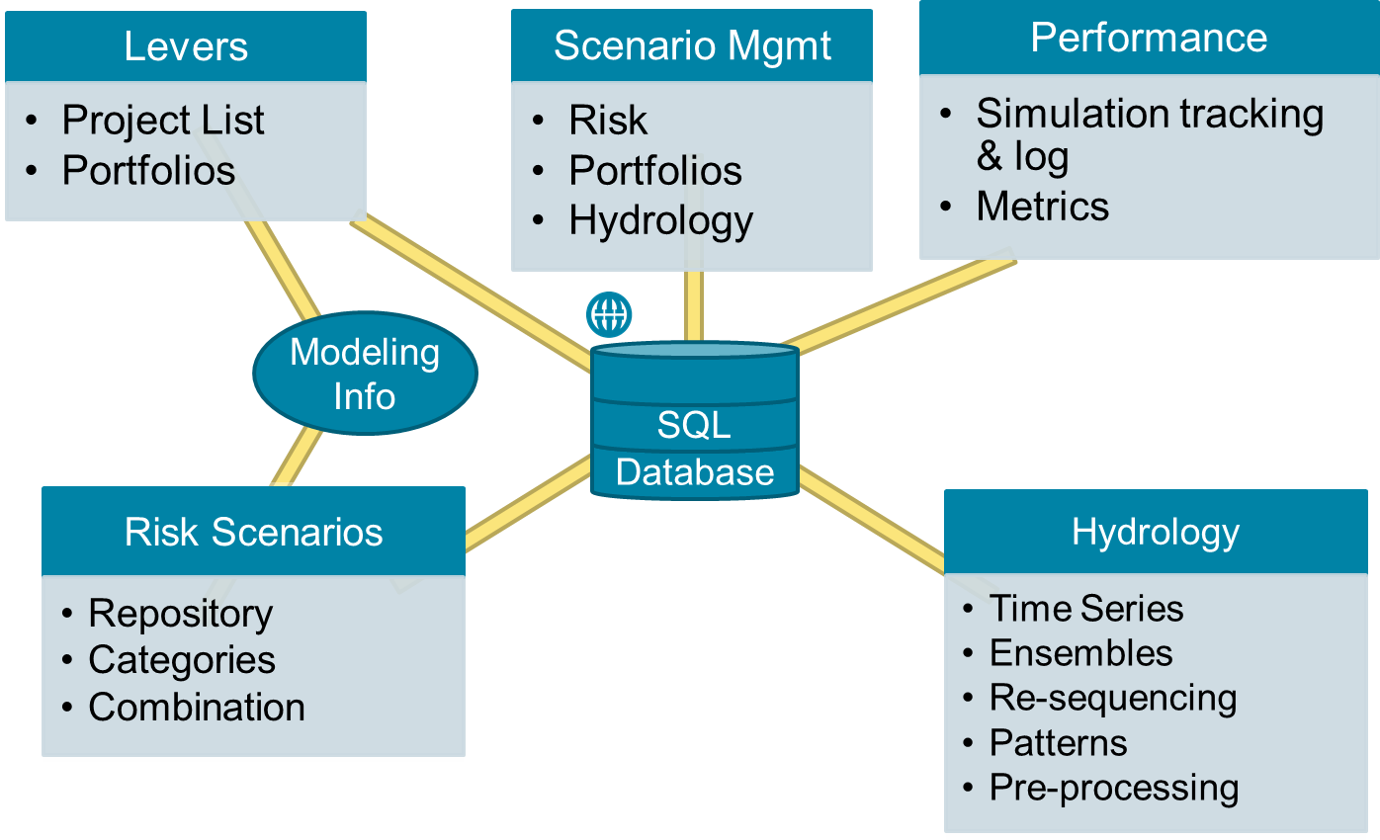

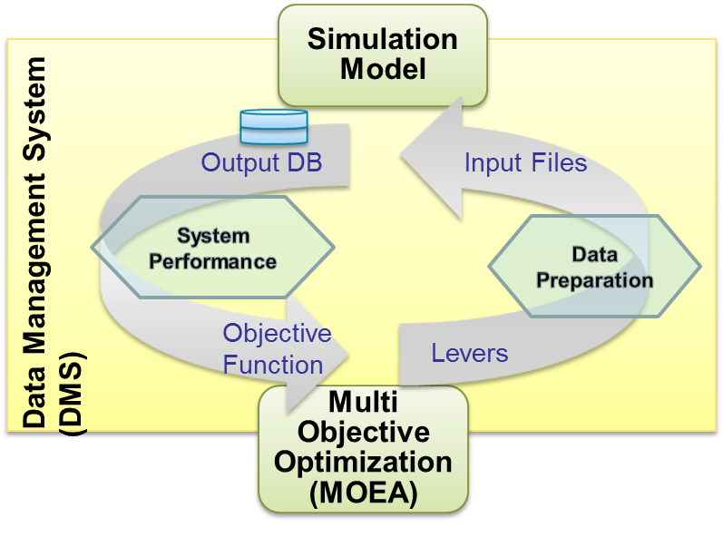

In Summary: Key Elements of the Modeling Management Systems
Simulation Models
Understand the complexities and system response to potential futures
Data-centered approach and DB functionality are key for the generalized framework
CRAM System Model
MODSIM Model
Simulation Model
Powerful engine to explore uncertainty & search for solutions
Output DB
Input Files
Packaging and Presenting Results
System Performance
Data Management System
(DMS)
Data Preparation
Objective Function
Levers
Multi Objective Optimization (MOEA)
Notes:
Performing these complex and time consuming analyses (and a lot of it) is manageable with modeling frameworks that take advantage of well structure database and Data management System (Adapters)
Packaging and presenting the results is where us planners participate and get involved in the decision making

Slide 28
Enrique Triana
Water Resources Management Division
etriana@rti.org
Thanks !
Questions or Comments?

